Slide 1

Learning API mappings for Programming Platforms
Yogesh Padmanaban
Computer Science Department
Rutgers University
Committee: Prof. Vinod Ganapathy (Chair), Prof. Badri Nath, Prof. Alex Borgida.

Slide 2

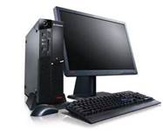
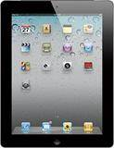







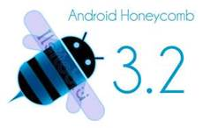





Variety of platforms
Desktop
Tablet
mobile
Notes:
We have diversity of platforms. Each of the platforms consists of Operating systems hardware and software. Each of the platform have their own programming constraints. A program or a software written for one platform cannot be reused in another platform as it is. We need to rewrite them according the tools and technologies of the new platform.

Slide 3

Portability of Apps
Tablet
Desktop
mobile
Notes:
The task of migrating an application from one platform to another platform is called platform migration. It is highly labor intensive, involves a lot of manual verification. Sometimes people employ new engineers on the new platform and work with old engineers to rewrite the entire software.

Slide 4
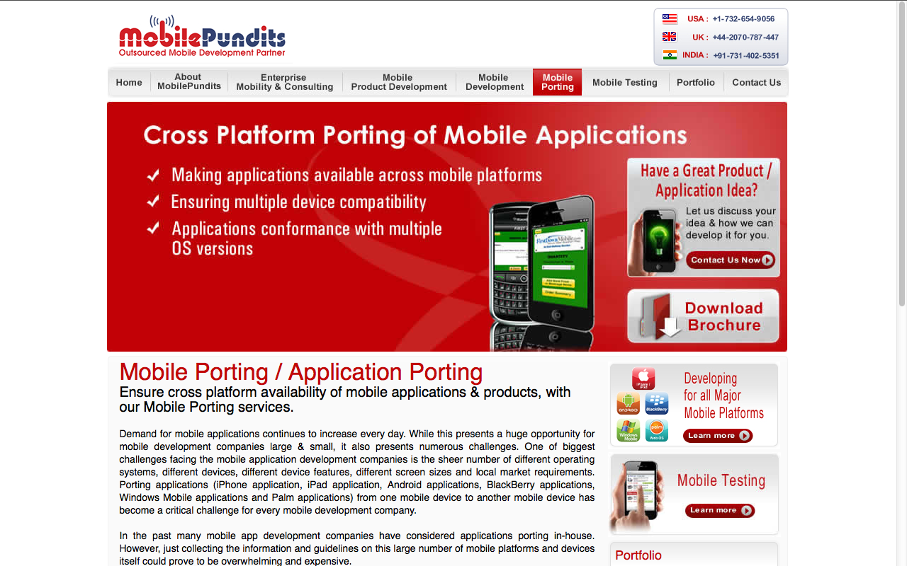
Porting of applications across mobile platforms
Notes:
There are third party support for migration between mobile platforms.

Slide 5
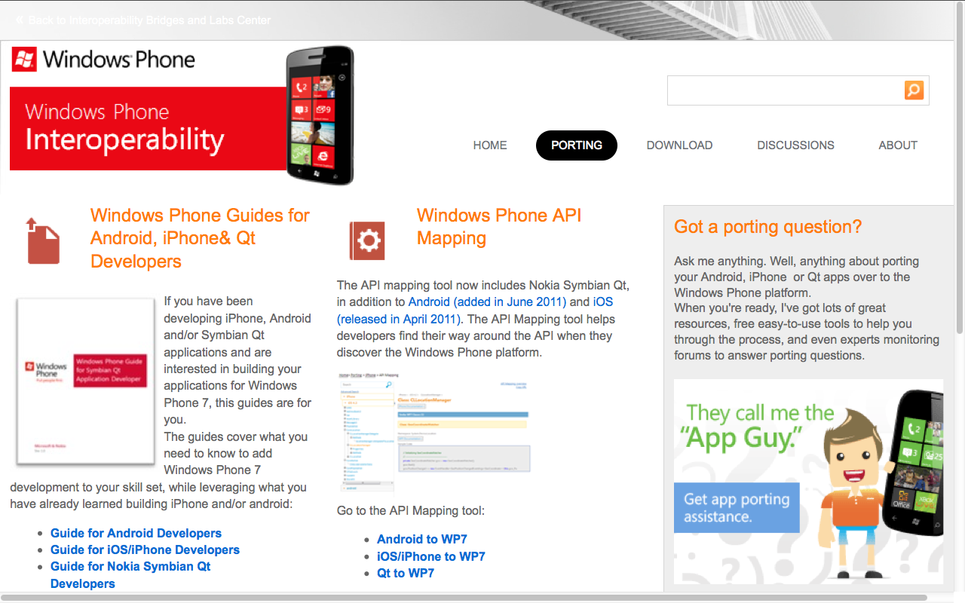
Windows platform migration
Notes:
Microsoft, ORACLE, IBM have their own migration team, One of the main task when migrating between platforms is mapping the API between the source and the target platform.

Slide 6

Porting applications
API Methods on Java ME
paint(Graphics g)
{
Graphics.setColor();
Graphics.fillRect();
Graphics.setColor();
Graphics.drawRect();
}
API Methods on Android
onDraw(Canvas c)
{
????
}
Notes:
Given a set of source API calls how do we find the corresponding target API calls. We automate the creation of mapping databases for any given source or target APIs

Slide 7

Mapping table
API Calls on Java ME
paint(Graphics g)
{
Graphics.setColor();
Graphics.fillRect();
Graphics.setColor();
Graphics.drawRect();
}
API Calls on Android
onDraw(Canvas c)
{
Paint.setColor();
Paint.setStyle(); Paint.drawRect();
Paint.setColor();
Paint.drawLine();
}
Library on Java ME | Library on Android
setColor() | setColor()
fillRect() | setStyle(); drawRect()
drawRect() | drawLine()
Notes:
We can simply have a mapping table which tells us which source API matches to which target API. We consider only names of methods not arguments. We consider only one to one /two mappings.

Slide 8

Validate the mapping table
Library on Java ME | Library on Android
setColor() | setColor()
fillRect() | setStyle(); drawRect()
drawRect() | drawLine()
Is this valid?
Notes:
The question: is the mapping table valid?

Slide 9
Mapping API of Programming languages
Rosetta Mapper:
Problem Statement: Given a set of source API methods, find the corresponding target API methods. Fill in the mapping table.
Rosetta Classifier:
Problem statement: Given a mapping table, Validate it.
Library on Java ME | Library on Android
drawImage() | drawBitmap()
fillRect() | setStyle(); drawRect()
drawRect() | drawLine()
Notes:
Thus we have two projects with us. One is Rosetta mapper and the Rosetta classifier. Rosetta mapper fills up the mapping table while the Rosetta classifier validates it.

Slide 10
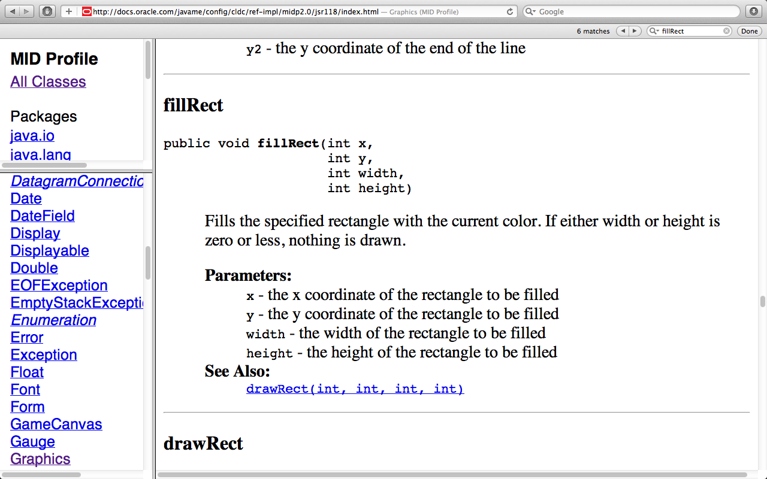
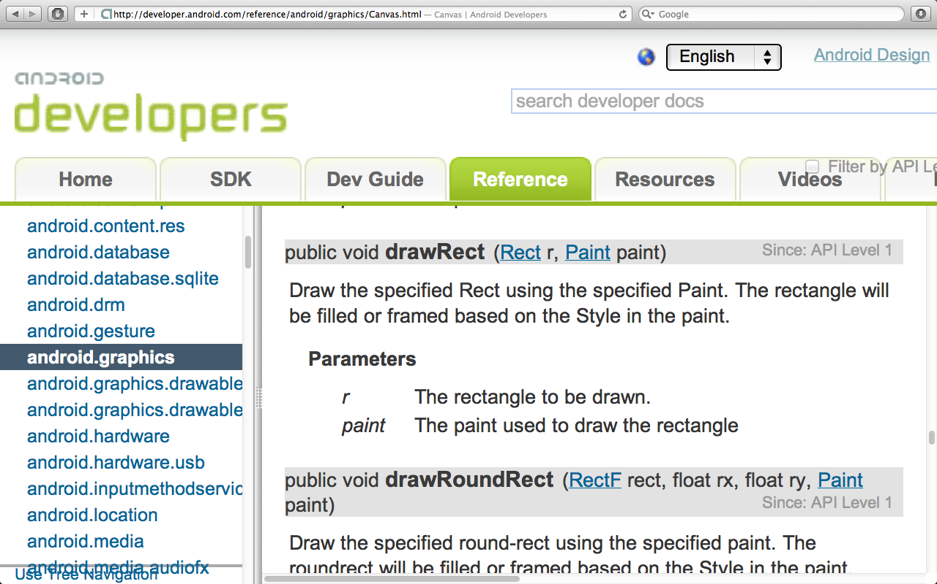
Mapping API of Java ME and Android Platform
Graphics API
Graphics API
Notes:
We have focused upon two platform. One is Java ME and the other API is Android Platform. why? Both are java like. Both are popular, both are mobile. It is a possible case for any one who has j2me game with them wants to go for an android game. We could try windows they are relatively new and not much applications are available. Ios, it is difficult to work with.

Slide 11
Outline
Motivation
Problem Definition
Rosetta Classifier
Rosetta Mapper
Implementation
Results
Conclusion
Notes:
This is the outline for todays discussion. We will go through Classifier now followed by Rosetta Mapper, Implementation, results and conclusion.

Slide 12
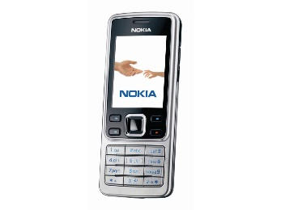

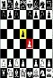
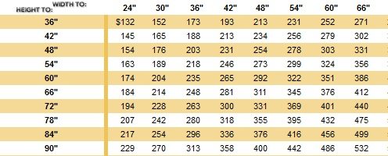
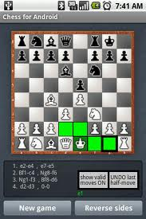
Rosetta Classifier (Validate a mapping)
Java ME Traces
Training data
Java ME games
Data set
Collect
Same Applications
Tracing
Generate Features
Pattern Classification
J2ME method | Android method | Decision
setColor | setStyle | True
setColor | fillRect | False
Android games
Android Traces
Notes:
This is the basic block diagram for Rosetta classifier. It starts with collecting visually same applications.

Slide 13
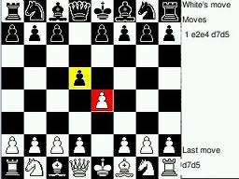
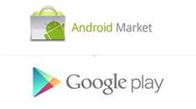


Collecting visually same application pairs
Collect same games on source and target platform
Looks /feels/plays alike.
Ex. chess on Java ME and chess on Android
Notes:
We collect applications which are visually as similar as possible. Yes there differences between implementations such sophistication of graphics, more screens, options, mouse/keyboard input, ads in between. We try to obtain approximately same applications.

Slide 14
Tracing
...
Graphics.setColor()
Graphics.fillRect()
Graphics.setColor()
Graphics.fillRect()
Graphics.fillRect()
Graphics.fillRect()
...
Controlled Execution
Java ME application
Java ME
Trace
Trace pair
// Same steps //
...
Paint.setStyle()
Color.parseColor()
Paint.setStyle()
Color.parseColor()
Canvas.drawLine()
Canvas.drawLine()
Canvas.drawLine()
Canvas.drawLine()
Canvas.drawLine()
...
Controlled Execution
Android
Trace
Android application
Notes:
We perform same move on both the games and obtain the traces, which has the API calls executed by the app.
Wrapper: if we wrap two calls into a new call. All three calls will be obtained in the traces. We filter out the classes we look for from the traces.

Slide 15
Generation of features
Mutual Information on frequency
Mutual Information on position
String edit-distance (Levenshtein distance)
Digram
Correlation coefficient of relative frequency(Pearson’s)
Longest Common Substring Length(LCSR)
Mapping | Mut-freq | Mut-pos | String-Edit | Digram | LCSR
drawRect Graphics::::::drawRect Canvas; | 0.696505 | 0.04312 | 26 | 3.772522 | 9
drawImage Graphics::::::drawBitmap Canvas; | 0.768054 | 0.108727 | 31 | 6.755305 | 7
Notes:
These features describe a mapping between two functional call. We collect for each possible functional calls, the corresponding vector of values. With these values we are going to predict whether the mapping is true or false.

Slide 16
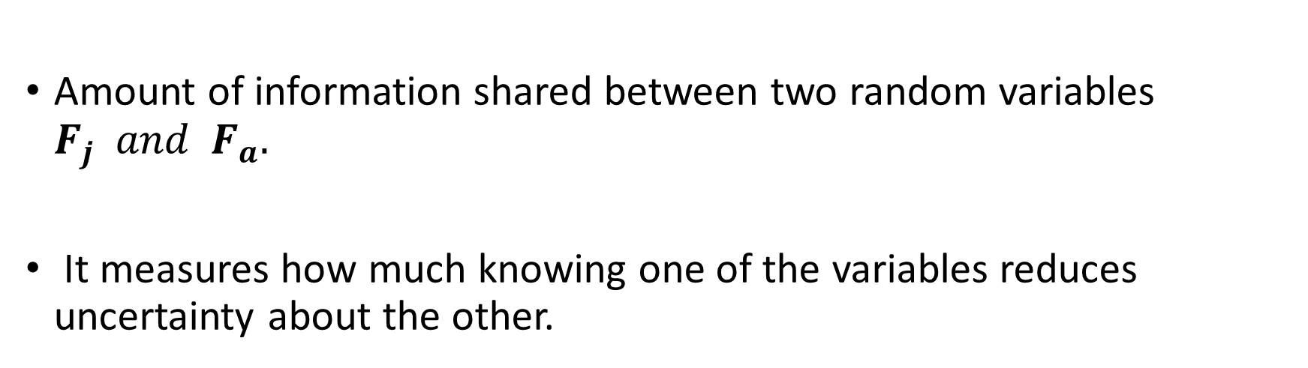
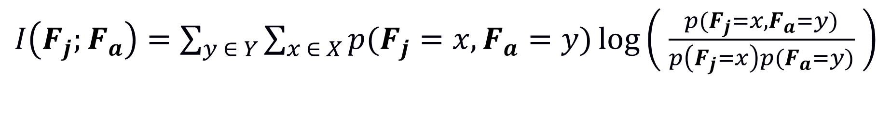
Mutual Information
Amount of information shared between two random variables $F_{j} and{ F}_{a}.$
It measures how much knowing one of the variables reduces uncertainty about the other.
$I\left(F_{j};F_{a}\right)=\sum_{y ∈ Y}{\sum_{x ∈ X}{p(F_{j}=x,F_{a}=y)\log\left( \frac{p(F_{j}=x,F_{a}=y)}{p\left(F_{j}=x\right)p(F_{a}=y)} \right)}}$

Slide 17
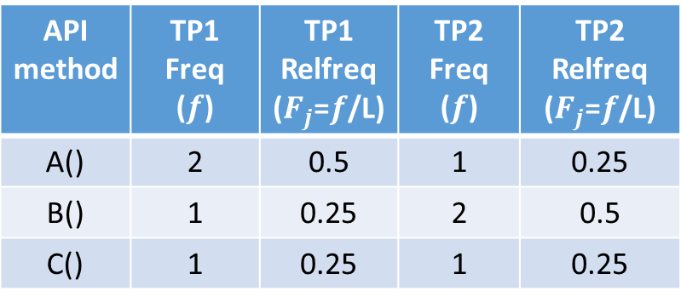
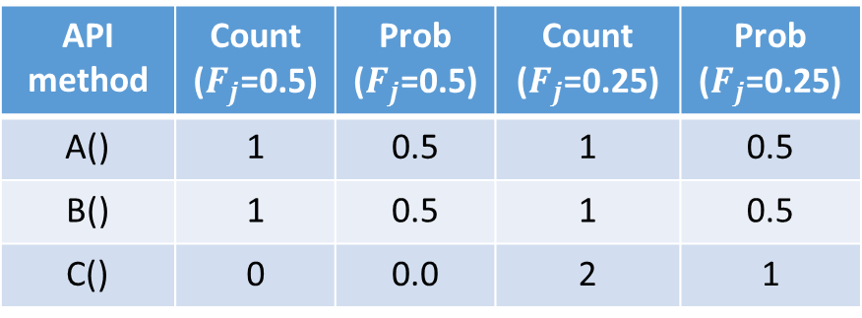
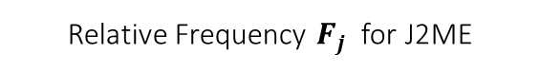
Mutual Information on frequency
J2ME trace
Android trace
J2ME
Android
J2ME
Android
A()
b()
A()
b()
A()
a()
B()
a()
B()
a()
B()
b()
C()
c()
B()
a()
C()
c()
A()
b()
C()
c()
Trace Pair 1
Trace Pair 2
Unique calls
Relative Frequency $F_{j}$ for J2ME
Probability of Relative Frequency ${P(F}_{j}=x )$ for J2ME
API method | TP1 Freq ($f$) | TP1 Relfreq ($F_{j}$=$f$/L) | TP2 Freq ($f$) | TP2 Relfreq ($F_{j}$=$f$/L)
A() | 2 | 0.5 | 1 | 0.25
B() | 1 | 0.25 | 2 | 0.5
C() | 1 | 0.25 | 1 | 0.25
API method | Count ($F_{j}$=0.5) | Prob ($F_{j}$=0.5) | Count ($F_{j}$=0.25) | Prob ($F_{j}$=0.25)
A() | 1 | 0.5 | 1 | 0.5
B() | 1 | 0.5 | 1 | 0.5
C() | 0 | 0.0 | 2 | 1
Total Traces N= 2
Trace length L = 4
Notes:
Consider a pair of trace files. TP1 and TP2. these are the unique possible calls from both the platforms. For each unique call we count the number of time it occurs in the trace file. Then divide it by the length of the trace to give relative frequency. We take a look at the values taken by the relative frequency. We count them for each such value what is the number of times it occurs. We now divide by the total number of traces. We probability of relative frequency taking a particular value.

Slide 18
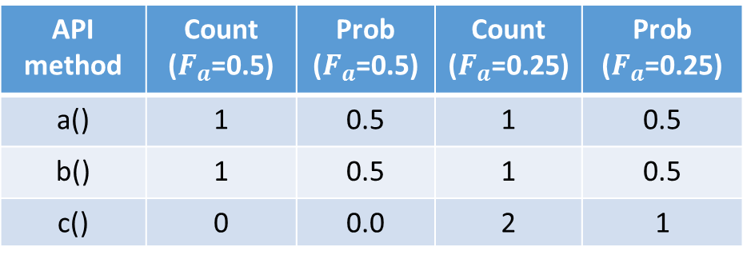
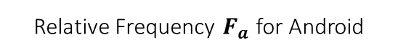
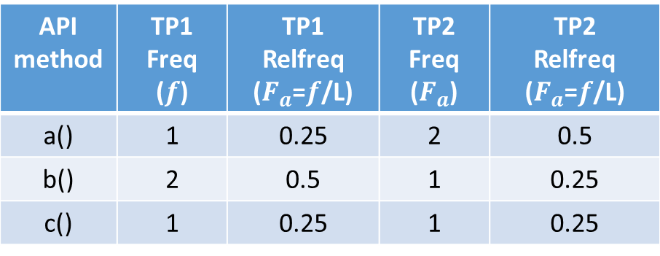
Mutual Information on frequency
J2ME
Android
J2ME
Android
J2ME
Android
A()
b()
A()
b()
A()
a()
B()
a()
B()
a()
B()
b()
C()
c()
B()
a()
C()
c()
A()
b()
C()
c()
Trace Pair 1
Trace Pair 2
Unique calls
Relative Frequency $F_{a}$ for Android
Probability of Relative Frequency $P(F_{a}=y)$ for Android
API method | TP1 Freq ($f$) | TP1 Relfreq ($F_{a}$=$f$/L) | TP2 Freq ($F_{a}$) | TP2 Relfreq ($F_{a}$=$f$/L)
a() | 1 | 0.25 | 2 | 0.5
b() | 2 | 0.5 | 1 | 0.25
c() | 1 | 0.25 | 1 | 0.25
API method | Count ($F_{a}$=0.5) | Prob ($F_{a}$=0.5) | Count ($F_{a}$=0.25) | Prob ($F_{a}$=0.25)
a() | 1 | 0.5 | 1 | 0.5
b() | 1 | 0.5 | 1 | 0.5
c() | 0 | 0.0 | 2 | 1
Trace length L = 4
Total Traces N= 2
Notes:
We compute similar values for android as well.

Slide 19
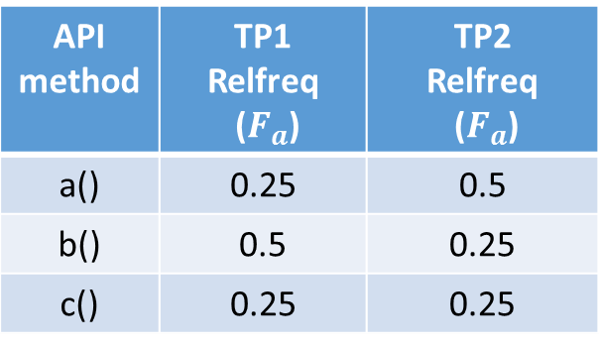
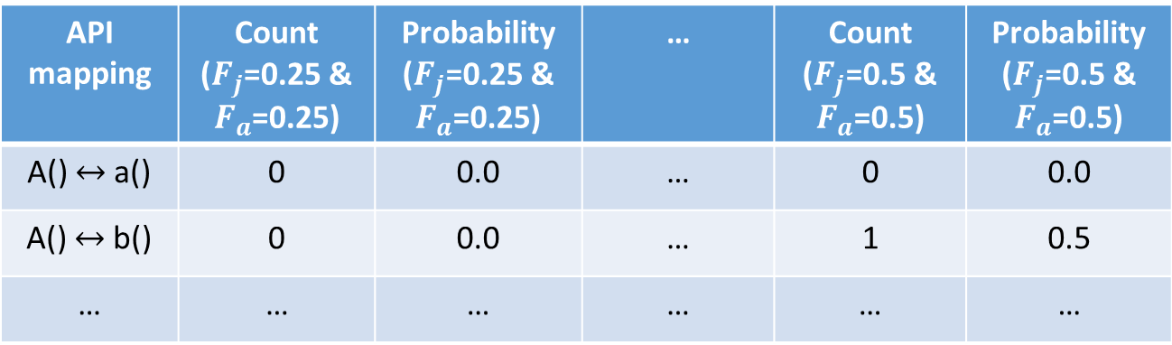
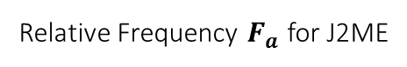
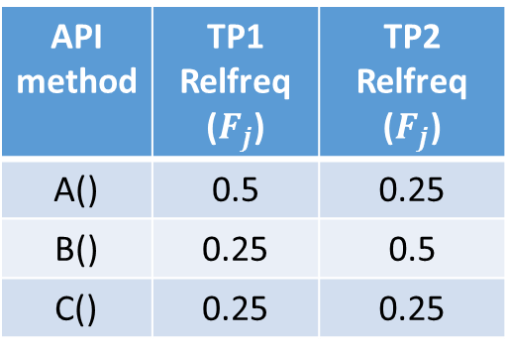
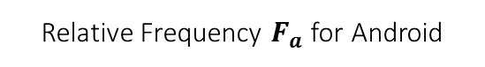
Mutual Information on frequency
Relative Frequency $F_{a}$ for J2ME
Relative Frequency $F_{a}$for Android
API method | TP1 Relfreq ($F_{j}$) | TP2 Relfreq ($F_{j}$)
A() | 0.5 | 0.25
B() | 0.25 | 0.5
C() | 0.25 | 0.25
API method | TP1 Relfreq ($F_{a}$) | TP2 Relfreq ($F_{a}$)
a() | 0.25 | 0.5
b() | 0.5 | 0.25
c() | 0.25 | 0.25
Joint Probability Distribution of relative frequency $P(F_{j}=x,F_{a}=y)$
API mapping | Count ($F_{j}$=0.25 & $F_{a}$=0.25) | Probability ($F_{j}$=0.25 & $F_{a}$=0.25) | … | Count ($F_{j}$=0.5 & $F_{a}$=0.5) | Probability ($F_{j}$=0.5 & $F_{a}$=0.5)
A() $↔$a() | 0 | 0.0 | … | 0 | 0.0
A() $↔$b() | 0 | 0.0 | … | 1 | 0.5
… | … | … | … | … | …
Total Trace pairs N = 2
Notes:
Now we compute the joint probability distribution. For every possible Fj, and Fa, we count the number of trace pairs. For which Fj=x and Fj= y.
We then divide by the total number of traces. We get the joint probability distribution of relative frequency. We fill this table for all possible mappings, for all possible relative frequency values.

Slide 20
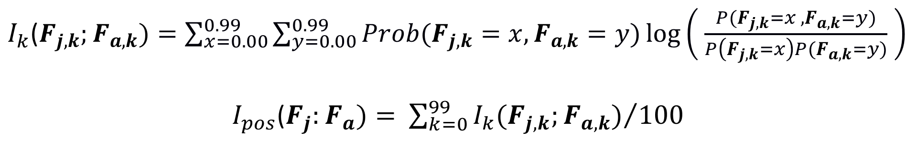
Mutual information on Position
J2ME Trace
J2ME
Positional Trace
Android
Positional Trace
Android Trace
[Mut-Info(0)]
.
.
.
[Mut-Info(99)]
$I_{k}$($F_{j,k};F_{a,k})=\sum_{x=0.00}^{0.99}{\sum_{y=0.00}^{0.99}{Prob(F_{j,k}=x,F_{a,k}=y)\log\left( \frac{P(F_{j,k}=x ,F_{a,k}=y)}{P\left(F_{j,k}=x\right)P(F_{a,k}=y)} \right)}}$
$I_{pos}$($F_{j}:F_{a})=$ ${\sum_{k=0}^{99}{I_{k}(F_{j,k};F_{a,k})}}/{100}$
Notes:
we divide the file into 100 pieces meaning we find mutual information on frequency for every 100 positions. We average them.

Slide 21
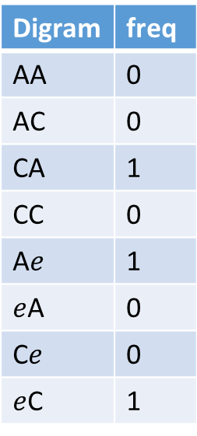
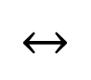
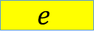
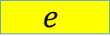
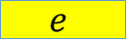
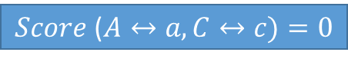
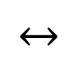
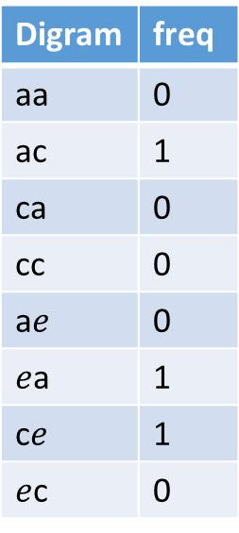
Digram
J2ME API
Android API
J2ME trace
Android Trace
A()
$$↔$$
a()
A()
b()
a()
A()
a()
A()
B()
b()
$$↔$$
B()
a()
c()
C()
c()
C()
c()
C()
c()
C()
A()
b()
Unique calls
Two mappings
Trace Pair
J2ME digram table
Android digram table
Digram | freq
AA | 0
AC | 0
CA | 1
CC | 0
A$e$ | 1
$e$A | 0
C$e$ | 0
$e$C | 1
$Score$ ($A↔a,C↔c)=0$
Digram | freq
aa | 0
ac | 1
ca | 0
cc | 0
a$e$ | 0
$e$a | 1
c$e$ | 1
$e$c | 0
A()
$$e$$
$$e$$
a()
C()
c()
A()
$$e$$
J2ME Digram trace
Android Digram trace
Yogesh Padmanaban
Notes:
We compute all the possible unique calls from both j2me and android traces. Then we take two mappings out of them. For each of the trace files available, we convert every other call to “e” epsilon. Now we count the pairs of AA to “eC”. And complete the table. We compare the entries of both the table and see if they are equal. For same value on both the digram table we add the score by 1.

Slide 22
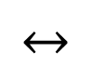
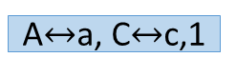
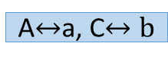
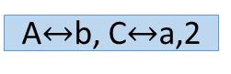
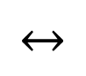
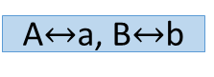
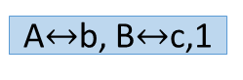
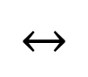
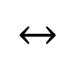
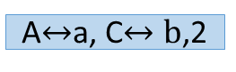
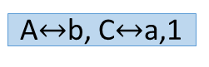
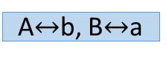
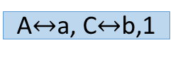
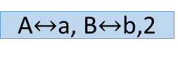
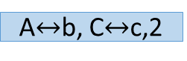



















Digram permutations for various mappings
A()
$$↔$$
a()
Trace Pair1
Trace Pair 2
Avg score
$$↔$$
C()
c()
A$↔$a, C$↔$c,1
A$↔$a, C$↔$c,2
A$↔$a, C$↔$c
$$↔$$
C()
b()
A$↔$a, C$↔$b,1
A$↔$a, C$↔b$,2
A$↔$a, C$↔b$
$$↔$$
B()
b()
A$↔$a, B$↔$b,1
A$↔$a, B$↔$b,2
A$↔$a, B$↔$b
$$↔$$
B()
c()
A$↔$a, B$↔$c,1
A$↔$a, B$↔$c,2
A$↔$a, B$↔$c
$$↔$$
A()
b()
$$↔$$
A$↔$b, C$↔$a,1
A$↔$b, C$↔$a,2
A$↔$b, C$↔$a
C()
a()
$$↔$$
C()
c()
A$↔$b, C$↔$c,1
A$↔$b, C$↔$c,2
A$↔$b, C$↔$c
$$↔$$
B()
a()
A$↔$b, B$↔$a,1
A$↔$b, B$↔$a,2
A$↔$b, B$↔$a
$$↔$$
…
B()
c()
A$↔$b, B$↔$c,1
A$↔$b, B$↔$c,2
A$↔$b, B$↔$c
Notes:
We have this permutation just for 3 unique api calls in both j2me and android. And two trace pairs. The total number of trace pairs is 100 for 10 games. For 21 games it 210. total number of unique calls is 281 and 3837.

Slide 23





Correlation Coefficient on frequency
Relative Frequency $F_{a}$ for J2ME
Relative Frequency $F_{a}$for Android
API method | TP1 Relfreq ($F_{j,1}$) | TP2 Relfreq ($F_{j,2}$) | Relfreq Mean $$\overline{F_{j}}$$
A() | 0.5 | 0.25 | 0.375
B() | 0.25 | 0.5 | 0.375
C() | 0.25 | 0.25 | 0.25
API method | TP1 Relfreq ($F_{a,1}$) | TP2 Relfreq ($F_{a,2}$) | Relfreq Mean $$\overline{F_{a}}$$
a() | 0.25 | 0.5 | 0.375
b() | 0.5 | 0.25 | 0.375
c() | 0.25 | 0.25 | 0.25
For two given relative frequency vectors of Android and J2ME API methods ($A() and a()$) $F_{a}$ and${ F}_{j}$ across $N$ trace pairs we compute:
$$r=\frac{\sum_{i=1}^{N}{\left(F_{j,i}−\overline{F_{j}}\right)\left(F_{a,i}−\overline{F_{a}}\right)}}{\sqrt{\sum_{i=1}^{N}{{\left(F_{j,i}−\overline{F_{j}}\right)}^{2}}}\sqrt{\sum_{i=1}^{N}{{\left(F_{a,i}−\overline{F_{a}}\right)}^{2}}}}$$
Notes:
We compute another metric based on relative frequency namely correlation coefficient of the frequency vectors.

Slide 24
Pattern Classification
Data set
J2ME method | Android method | Decision
setColor | setStyle | True
setColor | fillRect | False
Pattern Classification
Training data
Notes:
Now we go to the step where we perform classification of true/false we mappings. We computed data set from all the features. We need training data.

Slide 25
Feature Vector and Training data
Mapping | Mut-freq | Mut-pos | String-Edit | Digram | LCSR | Decision
drawRect Graphics::::::drawRect Canvas; | 0.696505 | 0.04312 | 26 | 3.772522 | 9 | true
drawImage Graphics::::::drawBitmap Canvas; | 0.768054 | 0.108727 | 31 | 6.755305 | 7 | true
Set 1: (Mut-freq, mut_pos, String-edit distance, Lcsr) around 86000 mappings.
Total of 7000 mappings were evaluated manually out of 86000 mappings.
We found around 393 true mappings for training data.
Set 2: (Mut-freq, mut_pos, String-edit distance, Digram, Lcsr) around 1500 mappings.
Set 3: (Mut-freq, mut_pos, String-edit distance, correlation coefficient and Lcsr) around 6000 mappings.
Notes:
Typical training data consists of manually evaluating them by going through the documentation. We obtained 3 sets of dataset. We worked on one of them first and then started collecting training data. Then we obtained more features and more training data so as to improve the classifier.

Slide 26


Supervised Learning : Classification
Given inputs $x ∈\{x_{0,}…,x_{n,}$} and target values $y∈ \left\{0,1 \right\}$,
Infer a function $f:X→Y$
x
x
x
x
y
y
y
y
Notes:
This is simple supervised learning technique we have labelled data and we apply the technique to obtain a decision boundary which separates the positive and the negative examples.

Slide 27
Support Vector machines
SVM is a non-probabilistic binary linear classifier.
It constructs a hyperplane in a high-dimensional space, which can be used for classification.
It produces maximum margin or distance to nearest data values of both category.
Performs nonlinear classification using kernels.

Slide 28
Support Vector Machines for linearly separable data
SVM classifies the linearly separable data using
Support vectors (yellow)
and the hyperplane decision surface.
Sample linearly separable data points in 2D.
Blue diamonds are positive examples
red squares are negative examples.

Slide 29

SVM kernels on non linearly separable points
Notes:
We see a Gaussian kernel to obtain the division between the positive and negative examples. We used a Bessel kernel in our experiments.

Slide 30
Classification Results
Divided the known dataset into training data(2/3) and testing data(1/3).
Dataset | True mappings | False Mappings
Training data | 259 | 2679
Testing data | 134 | 1335
Classification | True mappings | False mappings
Incorrectly classified | 18 | 95
Correctly classified | 116 | 1240
Notes:
We tone down the 7000 mappings to around 4000 values with lesser false mappings so as to help the classifier.

Slide 31
Precision and Recall measures
Recall R is the number of correctly classified positive examples divided by the total number of actual positive examples in the test set.
Recall= 116/134 =86%
Precision P is the number of correctly classified positive examples divided by the total number of examples that are classified as positive.
Precision= 116/116+95 = 54%

Slide 32



Rosetta Mapper (fill the Mapping table)
Java ME
game
Java ME Trace
Same applications
on source and target
Tracing
Generate Factors
Probabilistic Inference
Combine
Mappings
Across Traces
J2ME method | Android method | Probability Of match
setColor | setStyle | 0.6
setColor | fillRect | 0.45
Android Trace
Android
game
Notes:
This is the simple block diagram for rosetta mapper. We perform similar steps as before for the collection of traces. Instead of features we have factors here. We perform probabilistic inference vs non probabilistic inference before. We work on individual trace vs collection of traces for classifier. We combine the mappings across the traces and obtain the mappings.

Slide 33


Generation of Factors
Java ME
Trace
Factors generation
Android
Trace
Factors:
Set of Attribute values associated on the structure of the traces.
For every mapping $A↔a()$, we compute:
Frequency (ffreq)
Position (fpos)
Name (fname)
Method Context (fcontext)
Notes:
Let’s see what’s inside this box. Frequency refers to the ratio of relative

Slide 34

Factor graphs
A factor graph is a graphical model, that enables efficient computation of marginal distributions through the sum-product algorithm.
Express Joint probability distribution $P(X, Y)$of random variables $X, Y$ as a product of factors $f1(X), f2(X,Y)$ and $f3(Y)$.
$$P(X,Y) = f1(X) ∗ f2(X,Y) ∗ f3(Y)$$
X
f₁
factor nodes
Variable nodes
f₂
Y
f₃
Notes:
This is the graphical model for obtaining inference on the mapping. X and Y represents the random variable which takes values true and false. We compute the probability of the random variable taking that value.

Slide 35

Factor graph analysis
Assign probability to the factor node based on attribute values.
Obtain the marginal probabilities based on joint probability distribution using Bayes net toolbox in matlab.
Marginal probability is the probability that the mapping is true.
ffreq
p = 0.1
A()$↔$a()
fpos
p = 0.65
p = 0.25
p = 0.8
fcontext
p = 0.75
fname
Notes:
We give the values of the factors and the corresponding mappings as the input to the matlab bayes net tool box. We get the marginal probability by means of sum-product algorithm. Here the marginal probability is the probability that the random variable is true.

Slide 36
Combining mappings
Trace Pair 1
Java ME call | Android call | Prob
setColor | setStyle | 0.60
setColor | fillRect | 0.45
Weight {relative frequency}
Combine mappings
Java ME call | Android call | Prob
setColor | setStyle | 0.60
setColor | fillRect | 0.45
……..
……..
……..
Trace Pair N
Java ME call | Android call | Prob
setColor | setStyle | 0.60
setColor | fillRect | 0.45
Weight {relative frequency}
Notes:
We combine the mappings across traces using relative frequency of the j2me method.

Slide 37
Resultant mappings
Output the top 10 mappings.
Java ME call | Android call | Probability
Graphics.setColor() | Color.parseColor() | 0.8
Graphics.setColor() | Paint.setStyle() | 0.75
Graphics.setColor() | Canvas.drawLine() | 0.43
Graphics.fillRect() | Canvas.drawLine() | 0.87
Graphics.fillRect() | Color.parseColor() | 0.62
Graphics.fillRect() | Paint.setStyle() | 0.45
Notes:
Among several mappings obtained for every j2me method, we rank them according the probability of a mapping. We display the top ten mappings for each obtained mapping.

Slide 38
Implementation: Graphics API Mapping
Java ME Graphics API
Android Graphics API
Java ME
2.1 billion devices
Graphics API has 281 distinct methods
Android
300 million smartphones
Graphics API has 3837 methods

Slide 39
Implementation
Implemented Rosetta Mapper and Classifier to infer and validate mappings between Java ME and Android graphics API
Added instrumentation for Java ME and Android tracing.
Rosetta Mapper 1300 LOC , 21 board games.
Rosetta Classifier 2000 LOC, 10 board games.
Tools for Pattern Classification
R , statistical computing tool.
Kernlab package to implement kernel modules.
Used Bessel function for kernel.
Tool used for factor graph analysis
Bayes Net Toolbox from Matlab

Slide 40
Evaluation using independently developed games
Games | Number of traces | Games | Number of Traces
Minesweeper | 5 | Backgammon | 2
Snake | 2 | Blackjack | 5
Memory | 5 | Bubblebreaker | 4
Simple Dice | 5 | Checkers | 5
Solitaire | 3 | Chess | 5
Sudoku | 5 | Four in a row | 3
Tetris | 2 | Hangman | 3
Tic-tac-toe | 4 | Mahjongg version 1 | 5
Scrabble | 4 | Mahjongg version 2 | 5
Roulette | 5 | Othello | 3
Rubric's Cube | 3

Slide 41
Results using independently developed games
Java ME Class | Number of unique calls | # Mappings in top 10 | # True mapping at the top spot
Alert | 3 | 3 | 1
Canvas | 8 | 5 | 1
ChoiceGroup | 3 | 1 | 0
Command | 2 | 1 | 0
Display | 7 | 4 | 2
Displayable | 6 | 3 | 1
Font | 5 | 3 | 3
Form | 4 | 3 | 2
Game.Layer | 3 | 1 | 0
GameCanvas | 9 | 7 | 2
Graphics | 26 | 23 | 13
Image | 5 | 3 | 2
List | 1 | 1 | 1
All Calls | 82 | 58 | 28

Slide 42
Distribution of mappings
True mappings found among list of top 10 mappings for 71% of calls
Rank > 10
29%
Top Ranked
34%
Rank 6 to 10
14%
Rank 2 to 5
23%

Slide 43
Constraints
The method applies for API oriented programming languages.
Significant difference in games, tracing, sophistication of the APIs.
Scalability: lots of manual effort in tracing and verification. But it is possible to scale when finding similar applications is easy.
Computational constraints include unable to obtain all features (esp. digram) for all the available traces even after running the code in high end machines for a week.
We can extend the idea to larger set of APIs provided we have similar applications and way to validate them that they are similar.

Slide 44
Conclusion
Proposed a new approach to infer and evaluate mappings between source and target APIs
Implemented Rosetta Mapper to discover mappings between Java ME and Android graphics APIs.
“Inferring Likely Mappings Between APIs“, Amruta Gokhale, Vinod Ganapathy, Yogesh
Padmanaban. Proceedings of the 35th ACM/IEEE International Conference on Software
Engineering (ICSE 2013); pages TBD; San Francisco, California; May 18-26, 2013.
Implemented Rosetta Classifier to evaluate mappings between Java ME and Android graphics APIs.
True mappings in top 10 for 71% of Java ME calls.
Recall=86% Precision=54% for the classification of mappings using Rosetta Classifier.

Slide 45

Meanwhile…
API Calls on Android
onDraw(Canvas c)
{
Paint.setColor();
Paint.setStyle(); Paint.drawRect();
Paint.setColor();
Paint.drawLine();
}
API J2ME
paint(Graphics g)
{
Graphics.setColor();
Graphics.fillRect();
Graphics.setColor();
Graphics.drawRect();
}
Library on Java ME | Library on Android
setColor() | setColor()
fillRect() | setStyle(); drawRect()
drawRect() | drawLine()
Rosetta Mapper
Rosetta Classifier

Slide 46


